Slide 1
R CLINIC
Session 1 : Getting Started in R

Slide 2
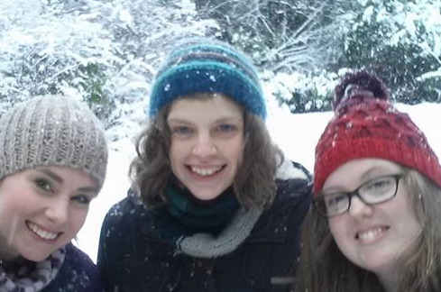
Who are we?
PhD students in the School of Biological Sciences
Katie Leach (kleach01@qub.ac.uk) – Third year
Studying the impacts of climate change on hares, rabbits and pikas
Hannah White (hwhite07@qub.ac.uk) – Second year
Studying the functional diversity of UK birds
Siobhán Porter (sporter14@qub.ac.uk) – Second year
Studying the impacts of hedgerow management on farmland birds

Slide 3
R Clinic format
Snippets of R - 10-15min session
Drop-in - any problems or questions
Resources
Access to slides via dropbox - email addresses

Slide 4

What is R?
“A language and environment for statistical computing and graphics”
Completely free
Regularly updated
Compatible with Windows, Mac, Linux
Increasingly used
There is a wealth of open access support for users
Command line, rather than menu driven
There is a steep learning curve, but we promise it’s worth it!

Slide 5
Why should I use R?
Analyse more or less any dataset
Publication-quality graphics
Easy to share scripts (which can be saved for future analysis)
Huge range of capabilities via add-on packages
Used in commercial as well as academic settings

Slide 6
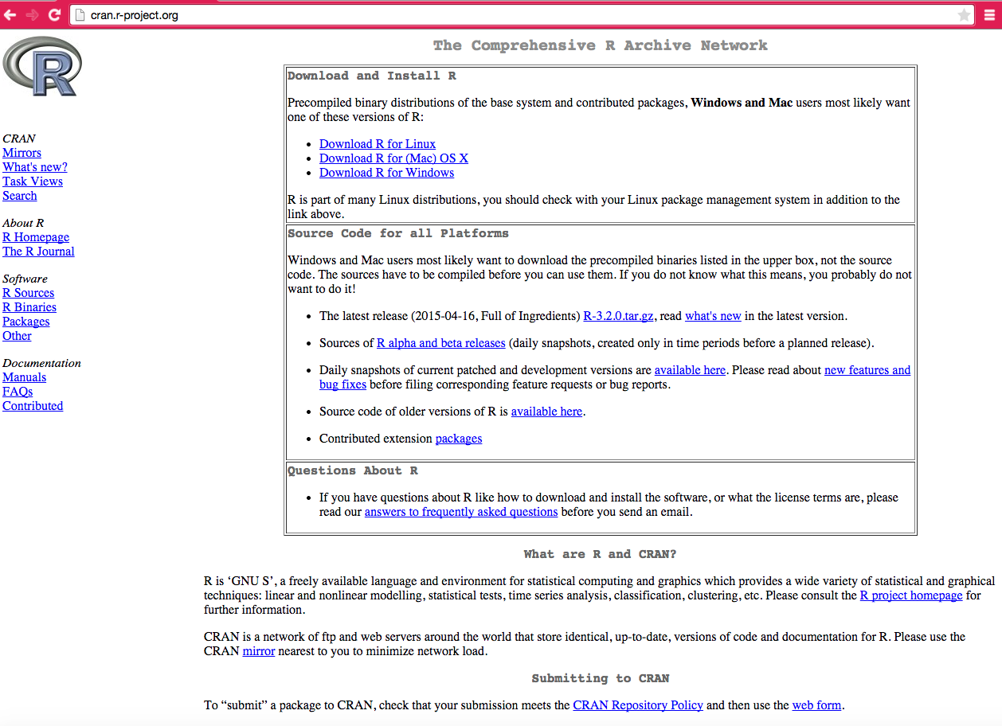
Downloading and installing R

Slide 7
RStudio
Why use RStudio? (some of the many great features!)
Easily edit, save and re-run R scripts
Menu features make getting started in R a little easier
It’s easy to keep track of imported data, objects and plots
Facilitates the easy creation of documents, presentations and reports
Download from www.rstudio.com

Slide 8
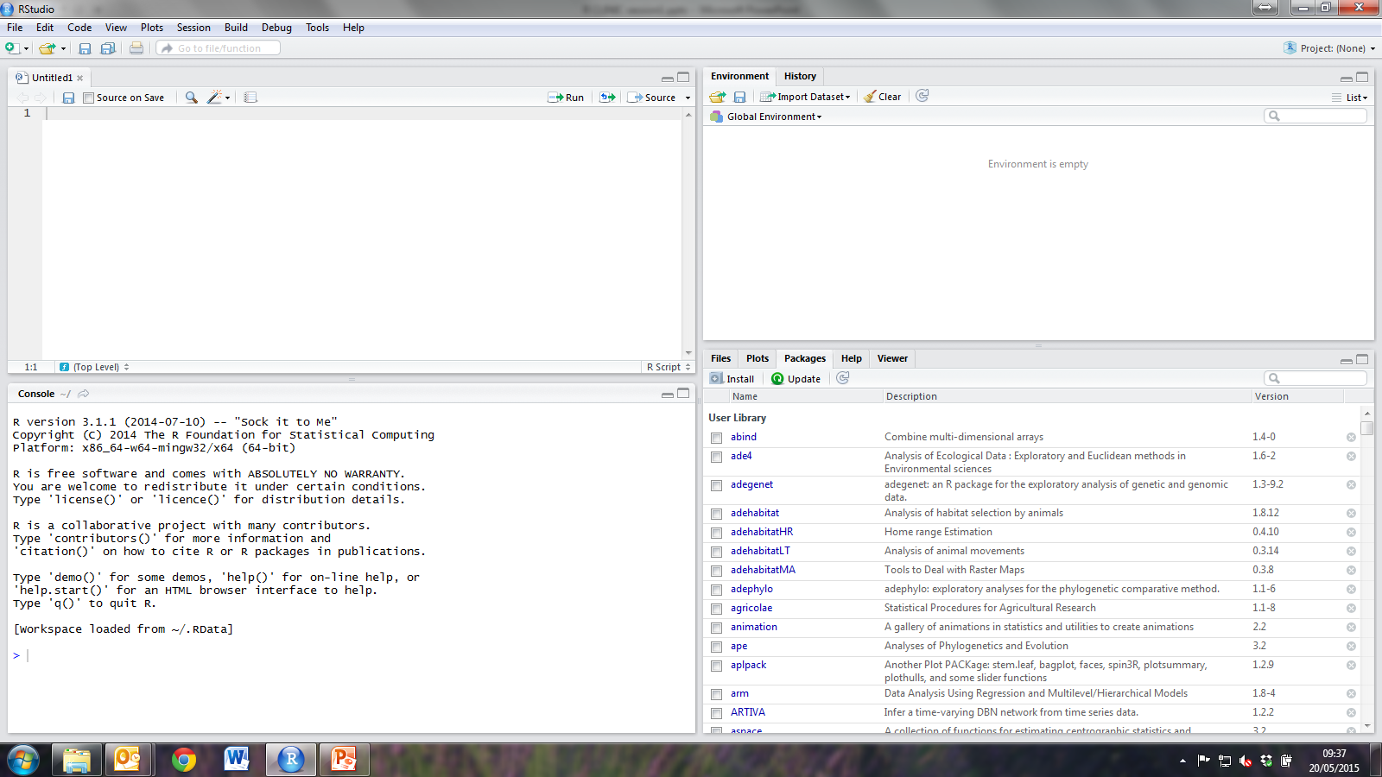
RStudio

Slide 9
R packages
“Collections of R functions, data and compiled code in a well defined format”
R comes with a number of packages already installed
More specialised packages can be installed for specific analyses, graphics etc.

Slide 10
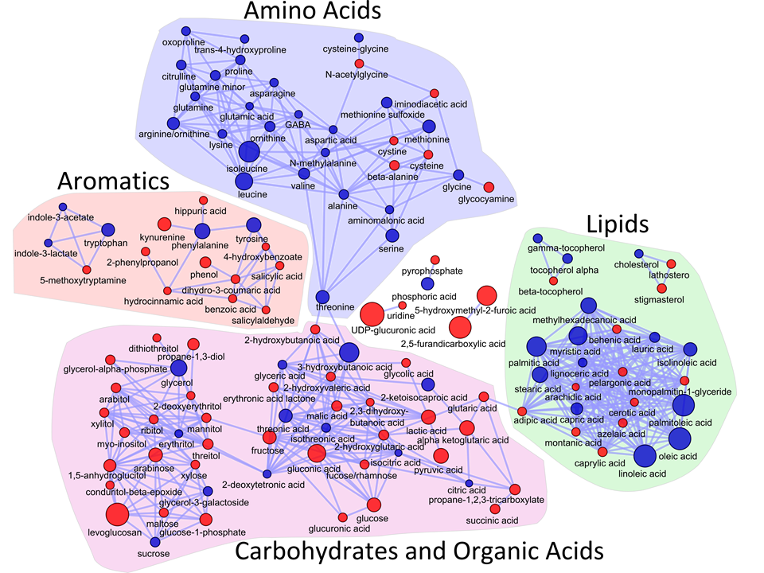
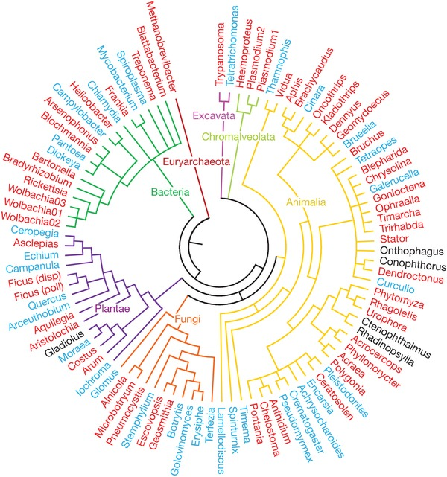
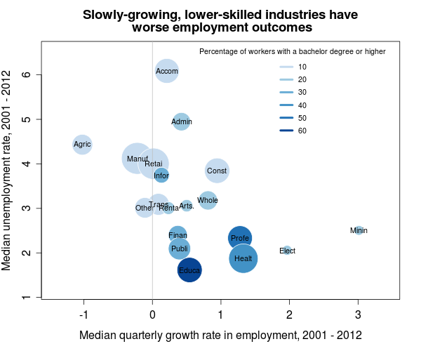
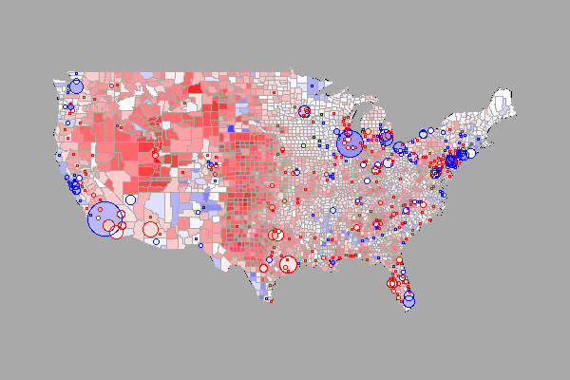
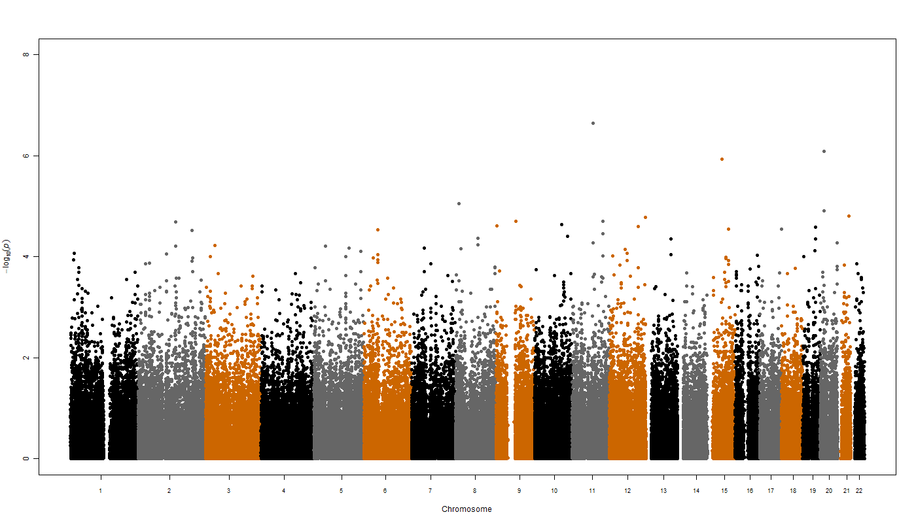
R packages

Slide 11
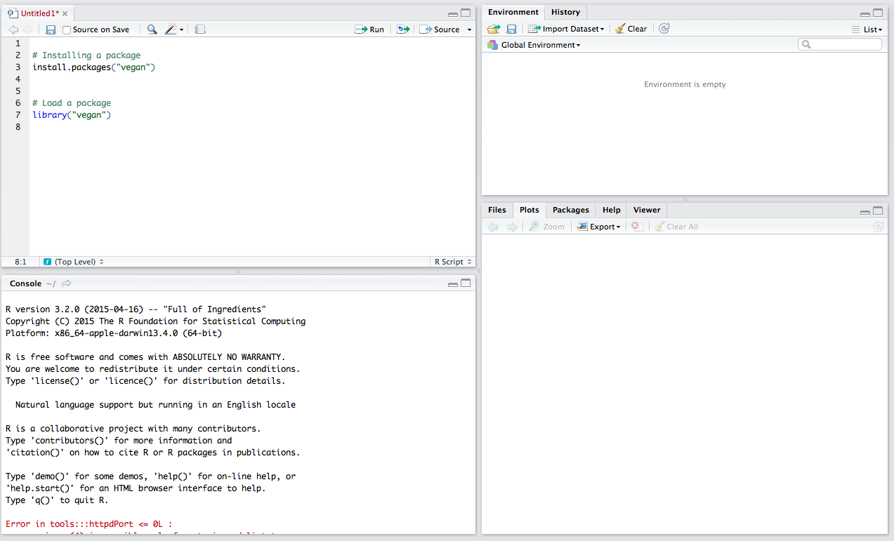
Installing and loading packages

Slide 12
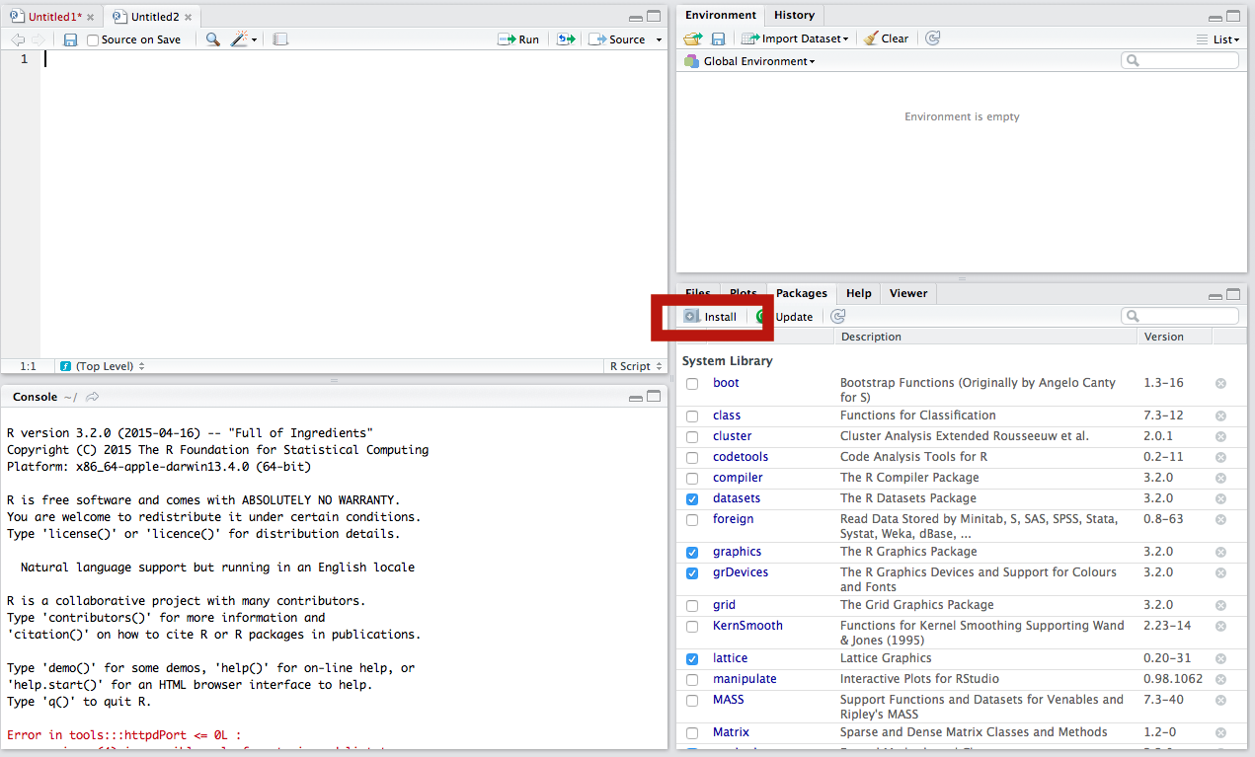
Installing and loading packages

Slide 13
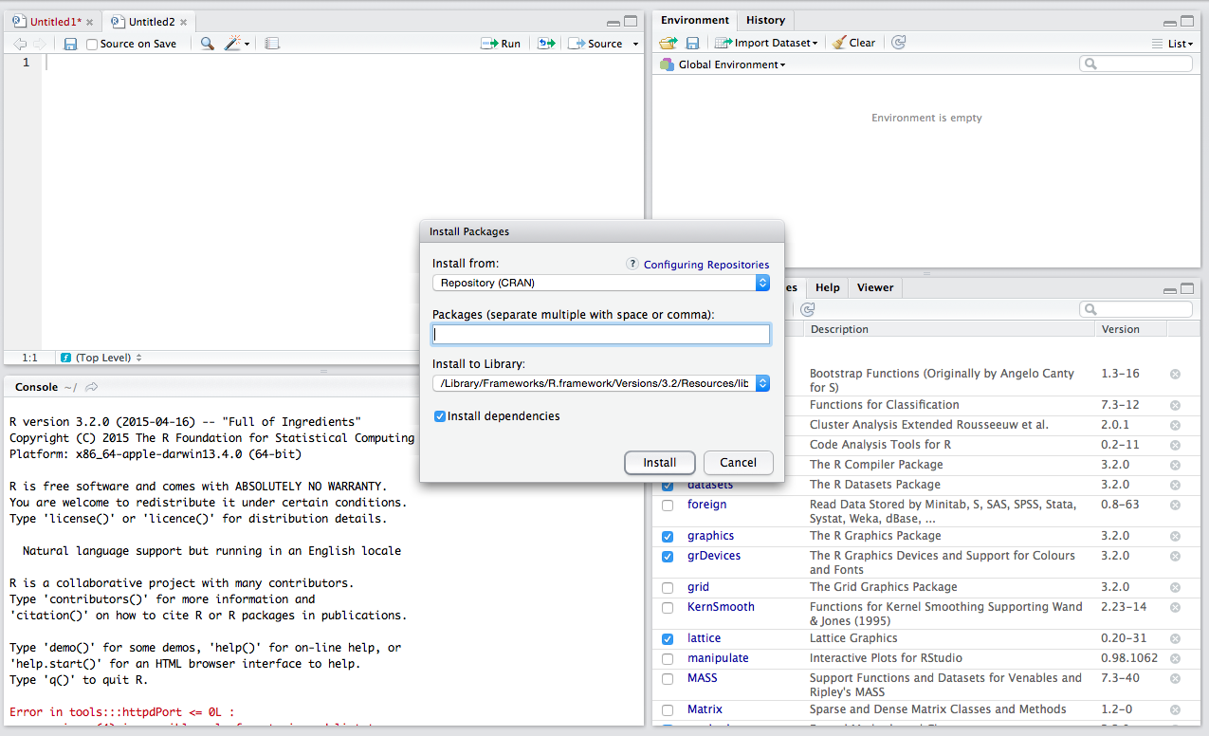
Installing and loading packages

Slide 14

Beginning to code
Remember: R is case sensitive
Comments are prefixed by ‘#’
Objects can be created with the ‘assign’ operator (<-)

Slide 15


Beginning to code
R can be used to carry out simple mathematic tasks
We can also begin to use R functions as follows:
And you can use e.g. ?mean to access help files

Slide 16
Data input
Most commonly, data are imported in .csv format
Note the use of forward ‘/’ in file pathways – this is different from the ‘\’ in Windows OS
Functions are available in R to import most data types, including:
Excel files
Outputs from other statistical packages (e.g. SPSS, SAS, Stata)
Spatial data (e.g. ArcGIS files)

Slide 17
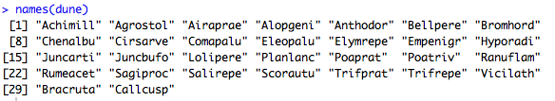
Viewing data
install.packages(“vegan”)
library(“vegan”)
data(dune) #Using the example data set “dune”
names(dune) #Names of an R object
names(dune) # gives variable names

Slide 18
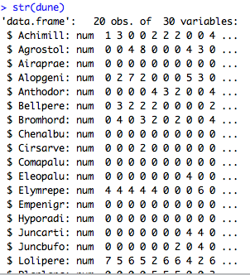
Viewing data
install.packages(“vegan”)
library(“vegan”)
data(dune) #Using the example data set “dune”
str(dune) #Structure of an R object

Slide 19
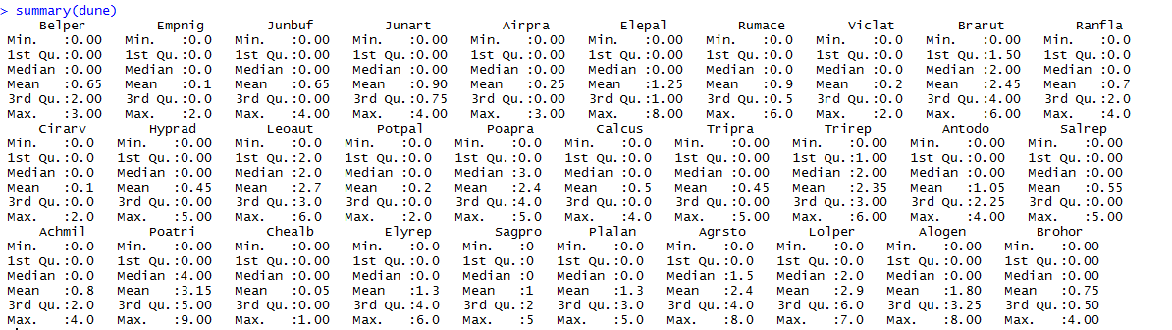
Viewing data
install.packages(“vegan”)
library(“vegan”)
data(dune) #Using the example data set “dune”
summary(dune) #Summary of an R object

Slide 20
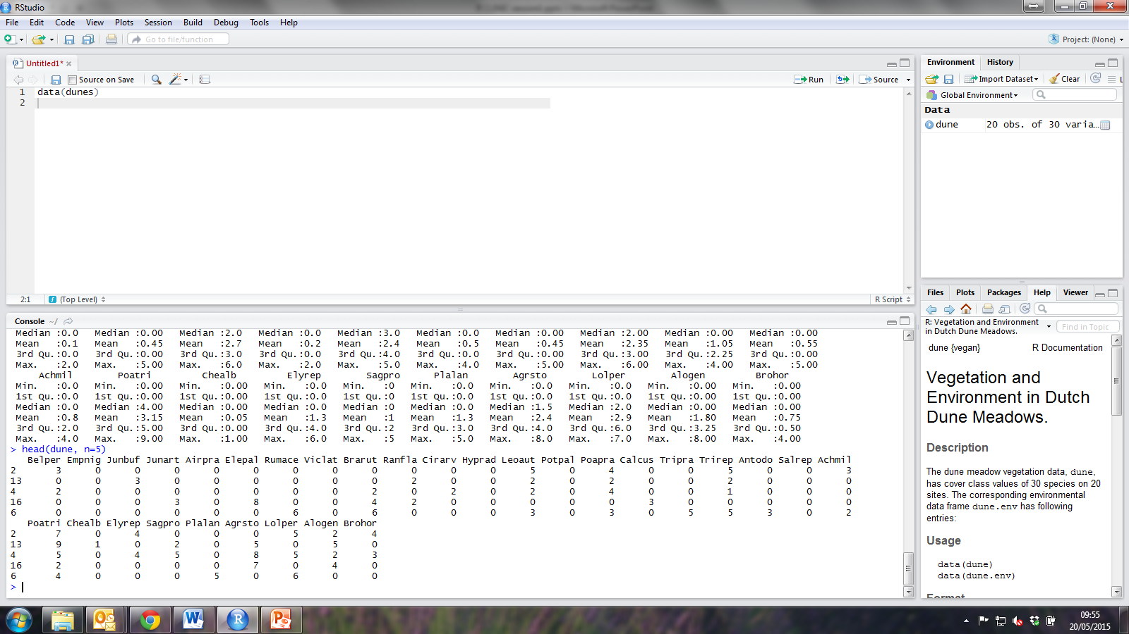
Viewing data
install.packages(“vegan”)
library(“vegan”)
data(dune) #Using the example data set “dune”
head(dune, n=5) #Print first 5 rows of an R object

Slide 21
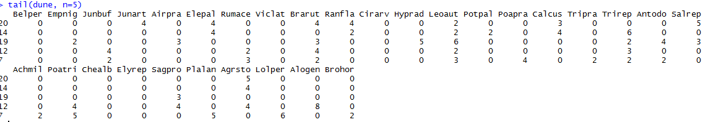
Viewing data
install.packages(“vegan”)
library(“vegan”)
data(dune) #Using the example data set “dune”
tail(dune, n=5) #Print last 5 rows of an R object

Slide 22
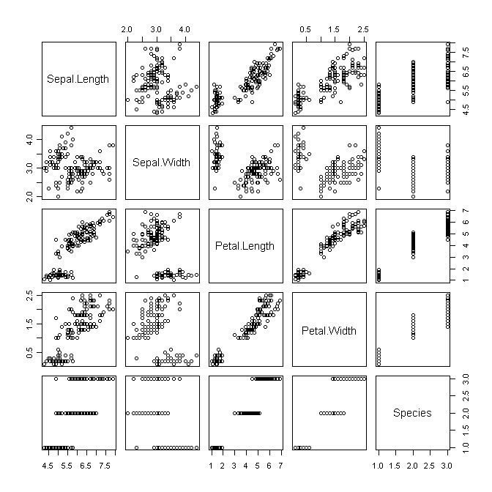
Next week:
DATA EXPLORATION!
But also email us with your suggestions for future sessions!

Slide 23
Further resources
Email any of us for a link to the R-Clinic Dropbox (kleach01@qub.ac.uk, hwhite07@qub.ac.uk or sporter14@qub.ac.uk)
For more tutorials and interactive online courses: https://www.datacamp.com/
For access to R books as PDF files: http://www.r-statistics.com/2009/10/free-statistics-e-books-for-download/

Slide 24



